Slide 1
Limitations of K-means
K-means has problems when clusters are of differing
Sizes
Densities
Non-globular shapes
K-means has problems when the data contains outliers.

Slide 2
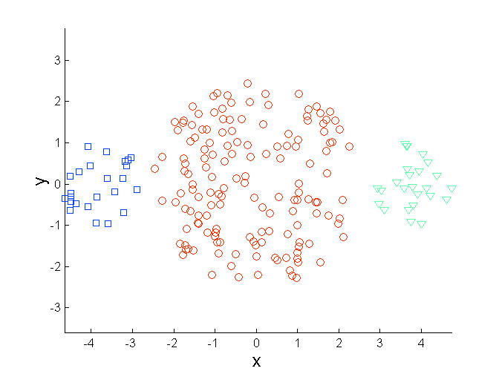
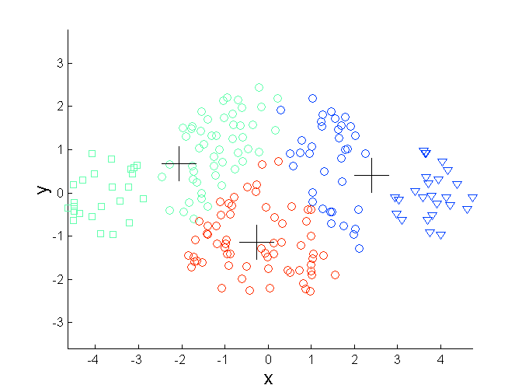
Limitations of K-means: Differing Sizes
Original Points
K-means (3 Clusters)

Slide 3
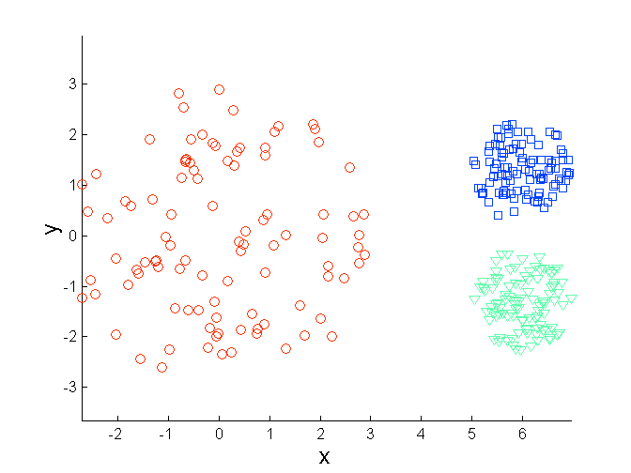
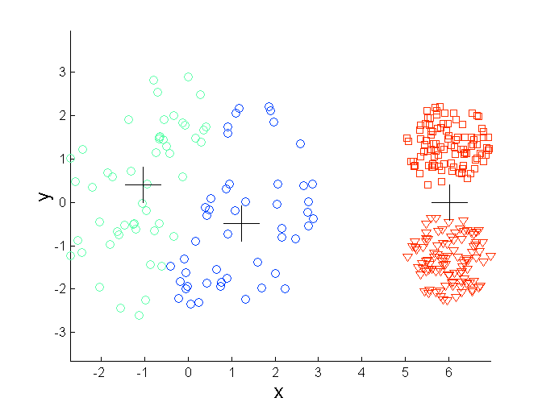
Limitations of K-means: Differing Density
Original Points
K-means (3 Clusters)

Slide 4
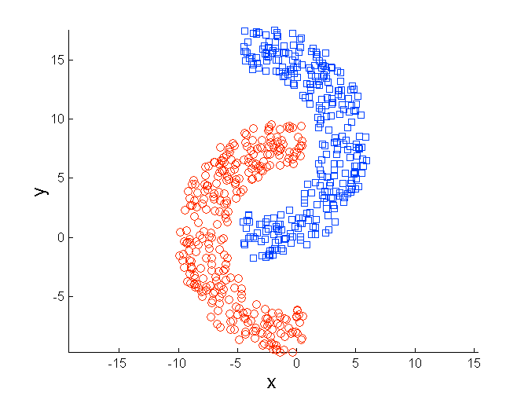
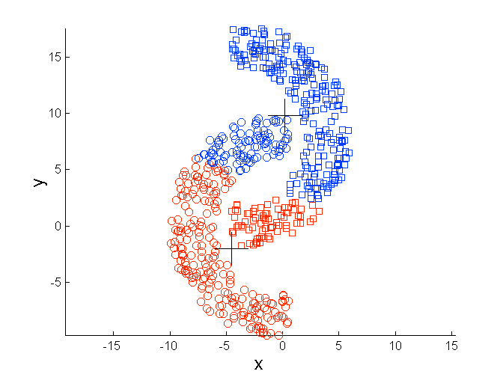
Limitations of K-means: Non-globular Shapes
Original Points
K-means (2 Clusters)

Slide 5
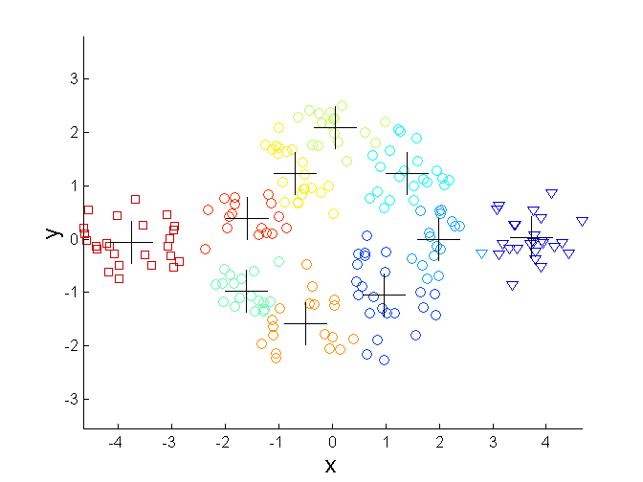
Overcoming K-means Limitations
Original Points K-means Clusters
One solution is to use many clusters.
Find parts of clusters, but need to put together.

Slide 6
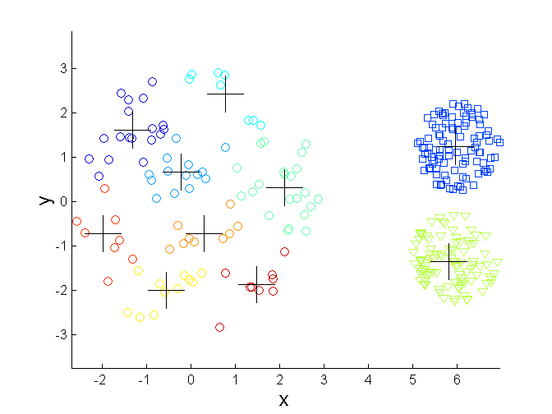
Overcoming K-means Limitations
Original Points K-means Clusters

Slide 7
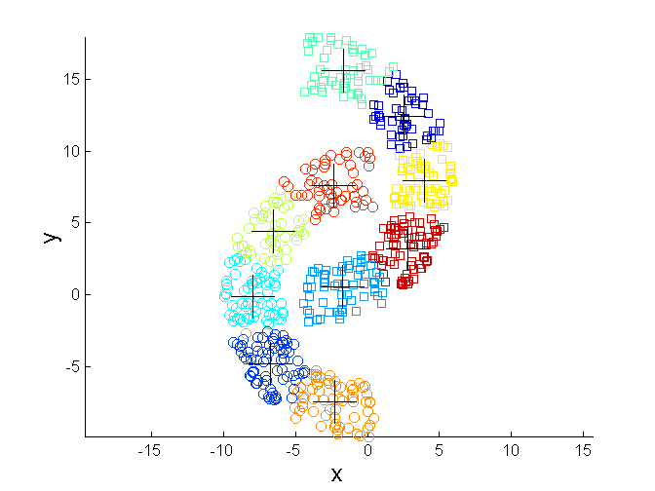
Overcoming K-means Limitations
Original Points K-means Clusters

