Slide 1
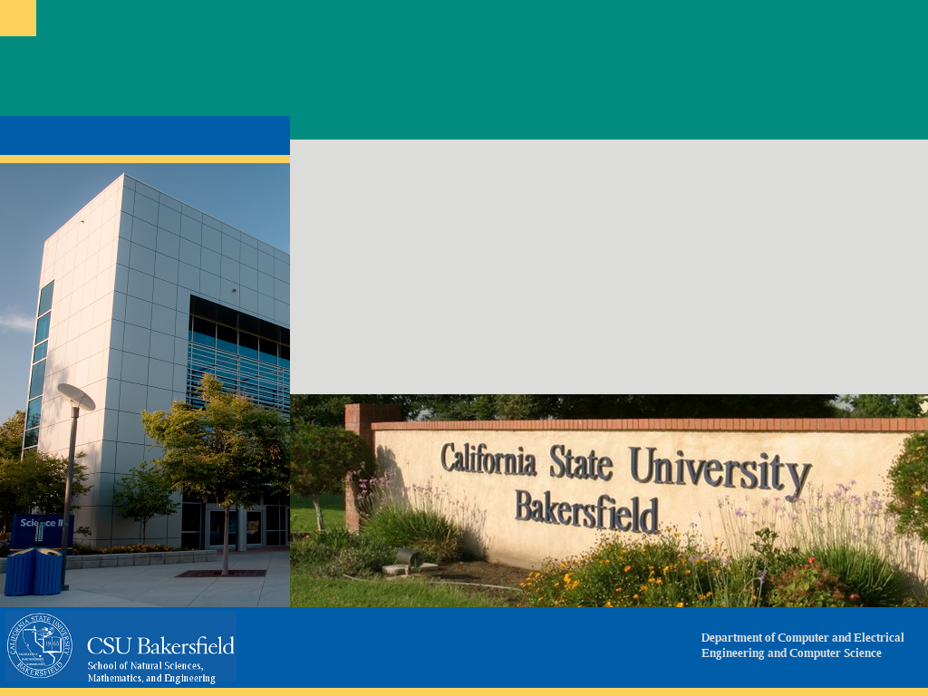
CMPS 3600 Operating Systems
September 3, 2025
Lab 2

Slide 2






Processes: Multiplying Work in Linux
How can your computer run Spotify and Chrome at the same time?
Notes:
Before we dive into system calls, let’s start with something familiar. Think about when you’re on your laptop. You might have Spotify streaming music, Chrome open with a dozen tabs, maybe Word running in the background. How does the computer juggle all of these at the same time? The answer is processes. Every running program is given its own process by the operating system. The OS switches between them quickly enough that it feels like they’re all running at once. This idea — that the OS can manage multiple processes — is what makes modern computing possible.

Slide 3
What is a Process?
A running program = a process
Has its own memory space, registers, and system resources
OS keeps track of processes in the process table
Notes:
A process isn’t just the program code. It’s the program code plus everything the operating system gives it: its own memory space, its registers, open files, and other resources. You can think of a process as a little universe. It has its own memory, its own environment, and the OS keeps track of it in something called the process table. That table is like the OS’s attendance sheet — it knows who’s present, what state they’re in, and how to manage them. This distinction — between a program and a process — is crucial for understanding fork.

Slide 4
Why fork()?
fork() creates a new process (child)
Child is a near-duplicate of the parent
Use heavily in shells, servers, multitasking
Parent
Parent
Fork()
Child
Notes:
Okay, so now that we know what a process is, how do we get a new one? In Unix systems, we use the system call fork(). What fork() does is really simple in concept but powerful: it duplicates the current process. You start with one process, and after fork(), you have two. We call the original the parent, and the new one the child. I like to compare this to making a photocopy. If you have a worksheet and put it in the copier, you now have two worksheets. They look the same, but from now on, you can write different things on each one. Similarly, the child process starts off as a copy of the parent but can go its own way.

Slide 5
What Happens on fork()
Two processes run the same code after fork
Return values differ: 0 in child, child PID in parent
Both continue from the same instruction point
Parent calls fork() pid_t pid = fork();
Child Process pid == 0 printf(“child”)
Parent Process pid > 0 printf(“parent”)
Notes:
Here’s where things get interesting. After a fork, you suddenly have two processes — but both are running the same code. How do you tell which one is which? That’s where the return value of fork() comes in. If the return value is zero, you know you’re in the child process. If it’s a positive number, that number is the child’s process ID, and you’re in the parent. Both parent and child continue executing from the same line in the program — the line right after fork(). That means the same code runs twice, once in each process, but the branch you take depends on the return value.

Slide 6
Common Uses of fork()
Launching new programs (fork + exec)
Running background tasks
Multiprocessing in servers
Every shell command forks, then execs
Notes:
So what do we actually use fork for? A really important example is your command shell. Every time you type a command like ls, the shell doesn’t run it inside itself. Instead, the shell forks — it makes a child process. The child process then uses another call, exec, to replace itself with the program you asked for. That’s how ls runs. Another common use is servers. A web server might fork a new process every time a client connects, so each client is handled separately. And of course, you can use fork to run things in the background — like a child process doing work while the parent continues.

Slide 7
Zombies & wait()
Child must be reaped by parent with wait()
If not, child becomes a zombie (Z state) in process table
Always:
Child calls exit()
Parent calls wait()
Parent fork() child
Child process exits
Zombie (Z) child waiting
Parent calls wait() Zombie reaped
Notes:
There’s one big rule when you use fork: the parent has to clean up after the child. When the child process ends, it doesn’t just disappear. It leaves behind an entry in the process table, which contains its exit status. We call that a zombie. If the parent never checks on the child — never calls wait() — that zombie stays in the process table, even though it’s not running. Too many zombies and the system can’t create new processes. So the fix is simple: the child should call exit() when it’s done, and the parent should call wait() to reap it. Once the parent waits, the zombie is cleared out of the table. That’s the proper handshake between parent and child.

