Slide 1
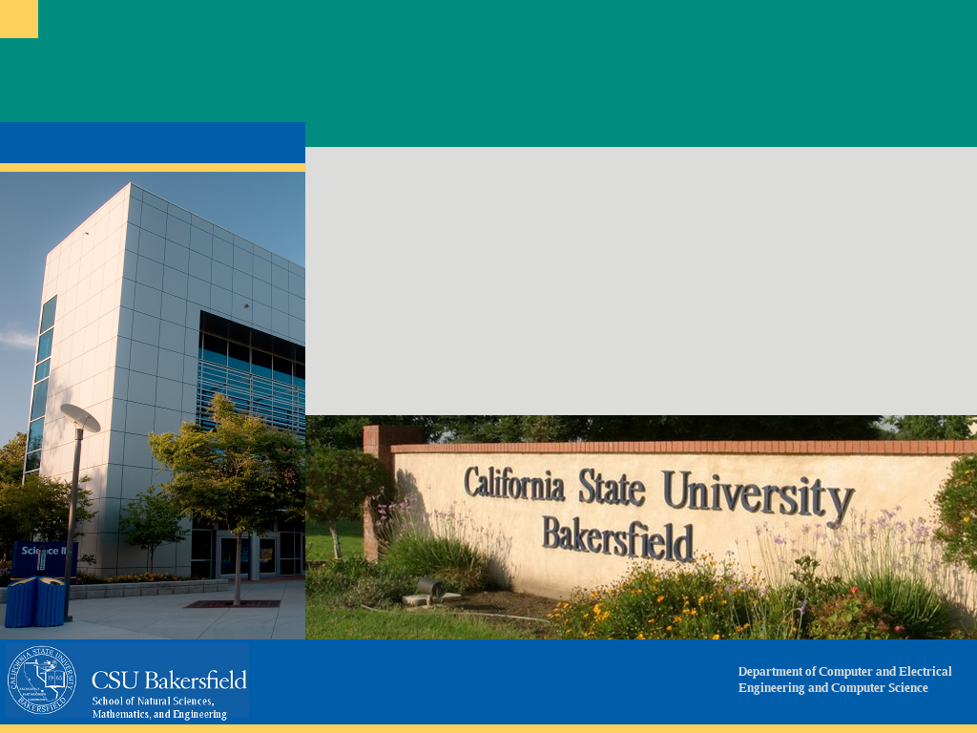
CMPS 3600 Operating Systems
September 17, 2025
Signals, Signal Masks, and Signal Handling

Slide 2

Signals in Linux
Asynchronous communication between processes
PARENT
CHILD

Slide 3

What are Signals?
Software interrupts delivered by the OS to a process
Default actions: terminate, stop, continue, ignore
Examples:
SIGINT (Ctrl+C)
SIGUSR1 & SIGUSR2 (user-defined)
SIGKILL (cannot be caught/ignored)

Slide 4
Why Do We Need Masks?
Signals can interrupt code anytime
Race condition: parent may send signal before child is ready
Without protection → premature termination

Slide 5
Signal Masks
A mask = list of blocked signals
Sigprocmask(SIG_BLOCK, …) blocks chosen signals
Protects critical code until ready
Child inherits mask from parent after fork()

Slide 6
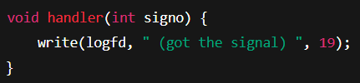
Safe Signal Handling
Register handler with sigaction
Handler runs when signal is received
Use only safe calls (e.g., write, not printf)
Block all signals during handler for safety

Slide 7

Synchronizing with sigsuspend
Temporarily swaps in a new mask & waits
Allows only the desired signal to wake process
Pattern:
Block everything
Setup handler
Fork child
Child: sigsuspend(mask_except_SIGUSR1)

Slide 8
Lab 3 Workflow
Child Process:
Open log, write “Go CSUB”
Wait in sigsuspend()
On SIGUSR1: log “ (got the signal) “
Log “Roadrunners!”, exit
Parent Process:
Send SIGTERM, then SIGUSR1
Call wait() for child
Print exit code

Slide 9
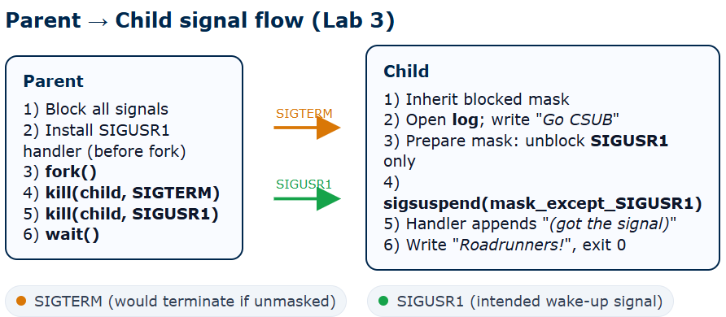
Lab 3 Workflow, cont.

Slide 10
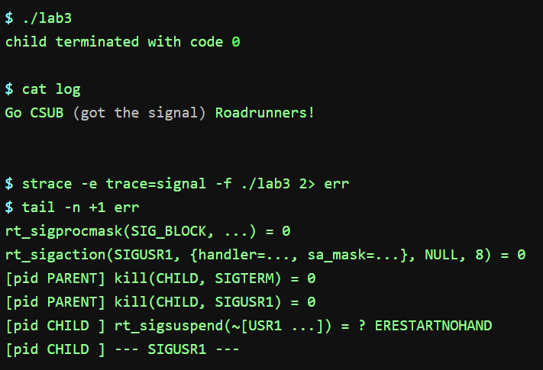
Lab 3 sample output

Slide 11
Why It Matters
Signals = OS tool for asynchronous communication
Used in
Job control (Ctrl+Z, fg/bg)
Timers/alarms
IPC in Unix/Linux systems
Masks/handlers = safety + synchronization

Slide 12
Key Takeaways
Signals = software interrupts
Masks = block/unblock as needed
Handlers = customer responses
Without careful handling → race conditions & deadlocks

